Slide 1

ASSESMENT REPORT
Prepared By: Carlton Musuka
Role: Analytics Engineer
Date: 26/05/2025

Slide 2

Task 1
Objectives
Convert a .parquet file into a CSV file by using AWS S3 buckets and a Lambda function

Slide 3
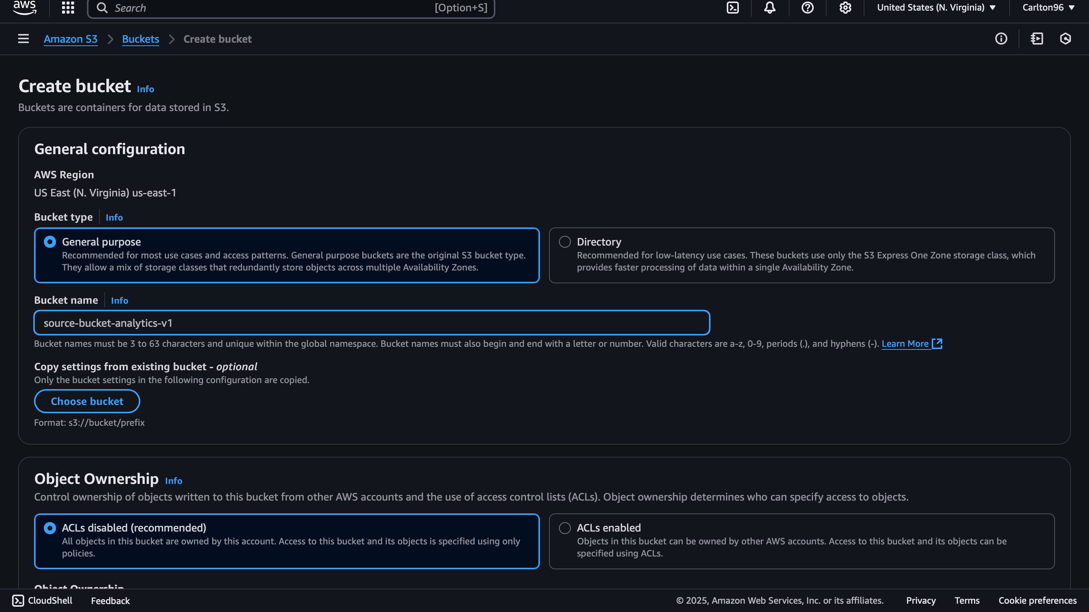
Notes:
Creation of the source bucket using a unique global name

Slide 4

Notes:
Creation of the processed bucket using a unique global name

Slide 5
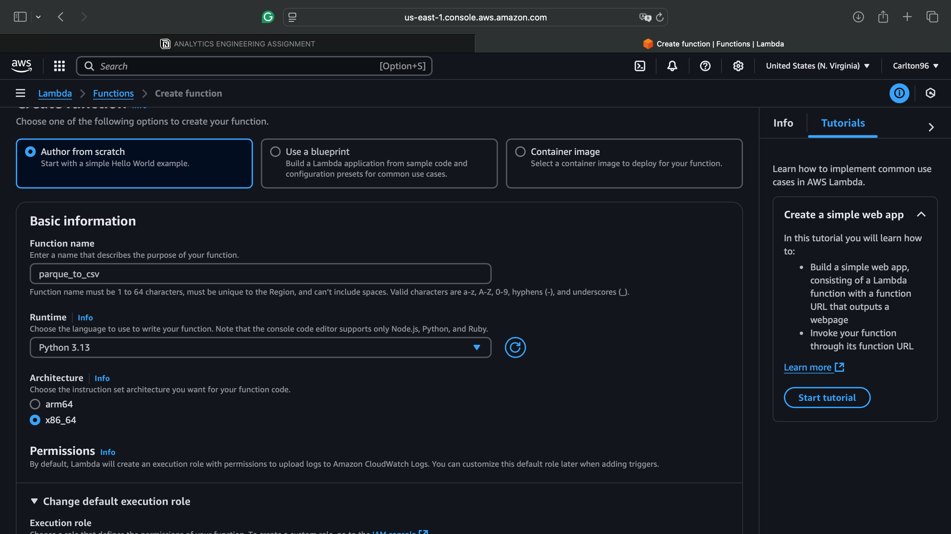
Notes:
Creation of a Lambda function

Slide 6
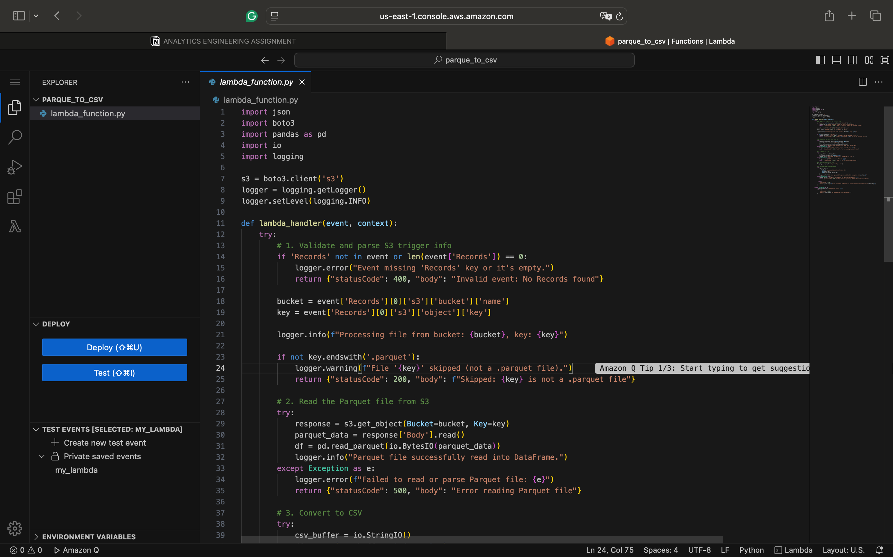
Notes:
Lambda function code snippet

Slide 7
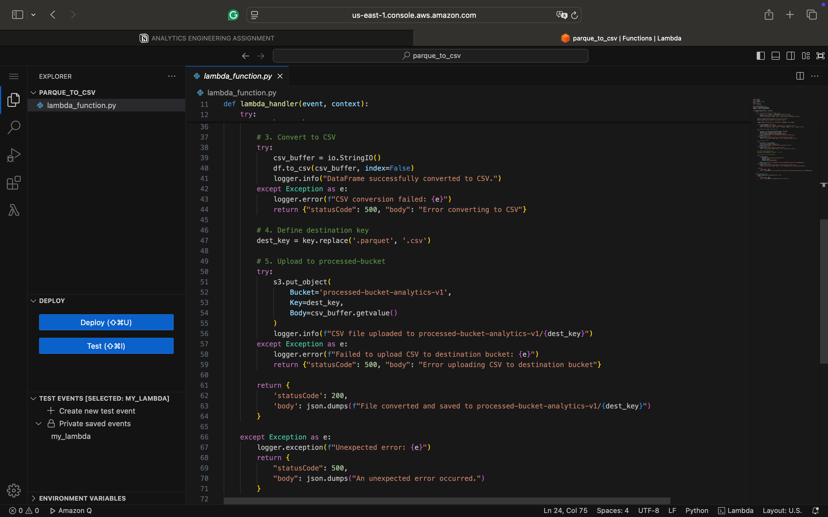
Notes:
Lambda function code snippet

Slide 8
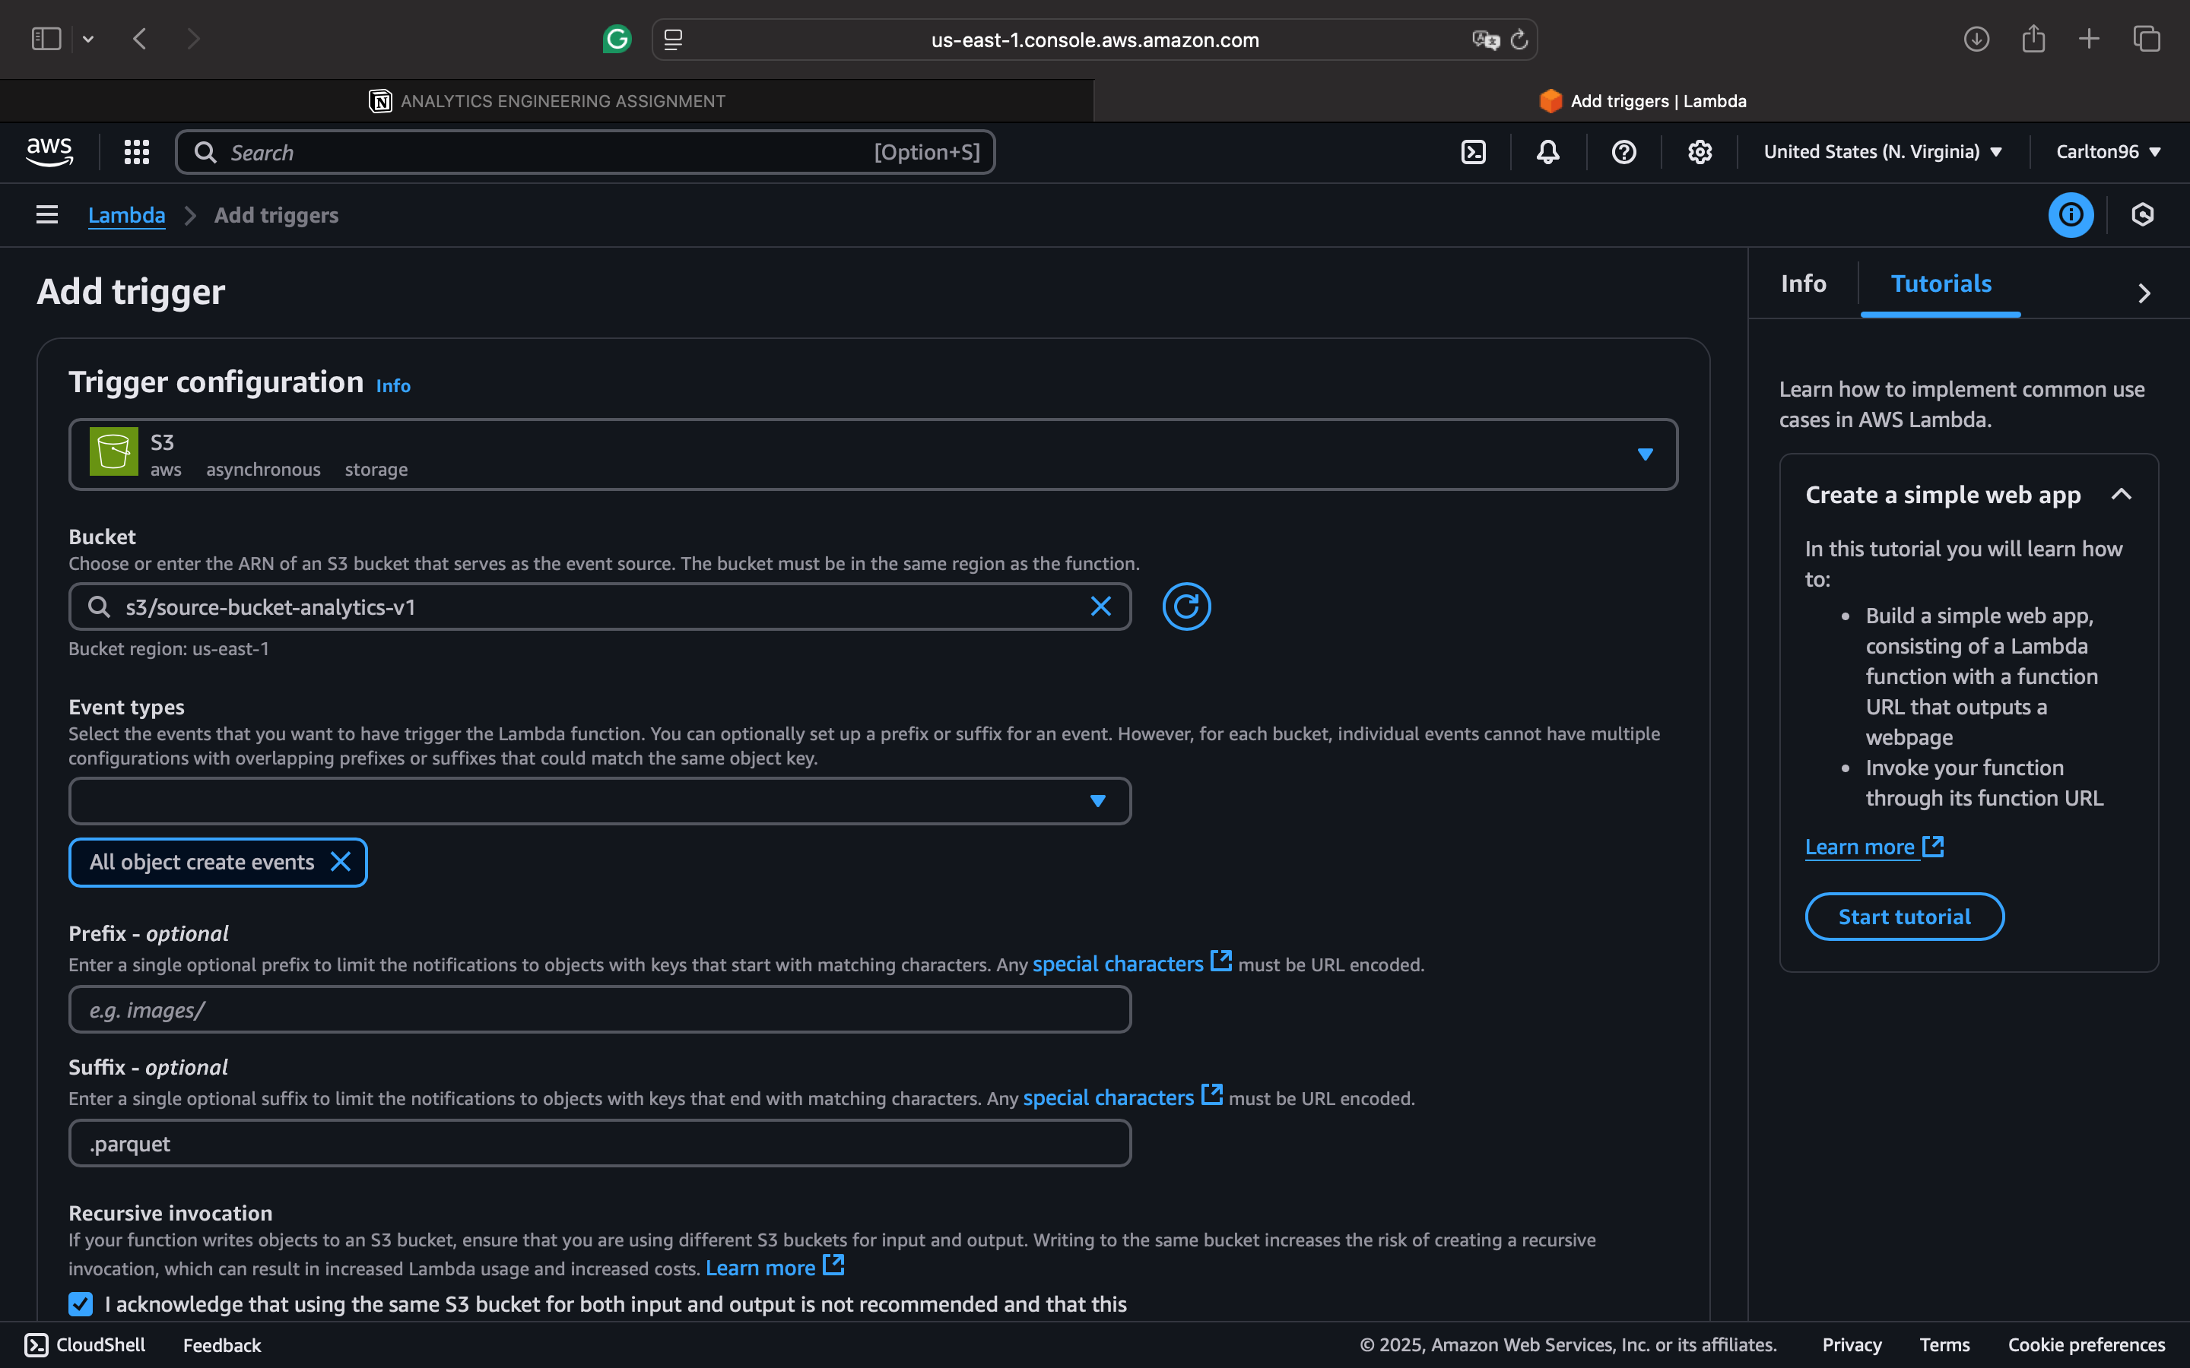
Notes:
Creation of a Trigger

Slide 9
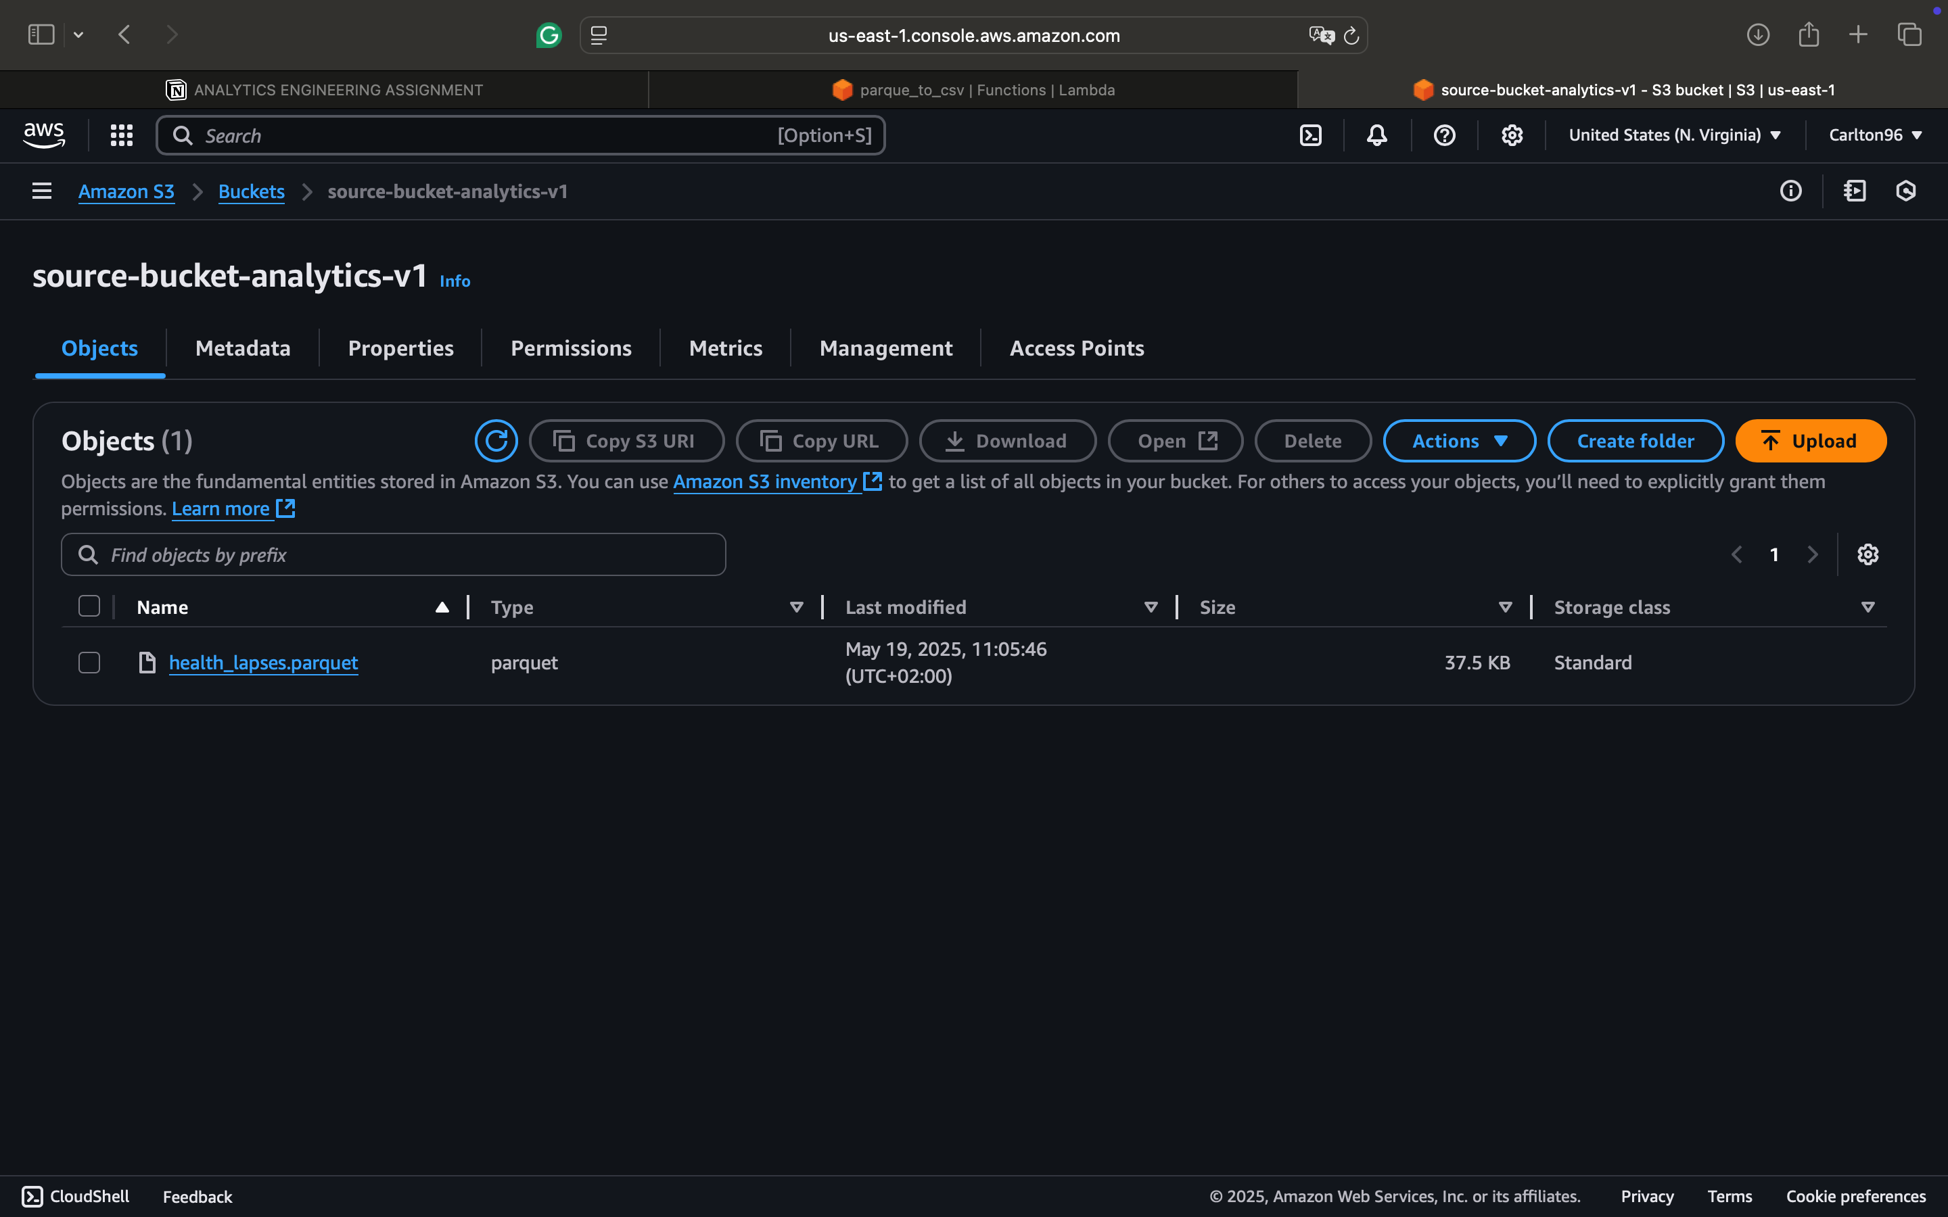
Notes:
Uploading a .csv file in the source S3 bucket

Slide 10
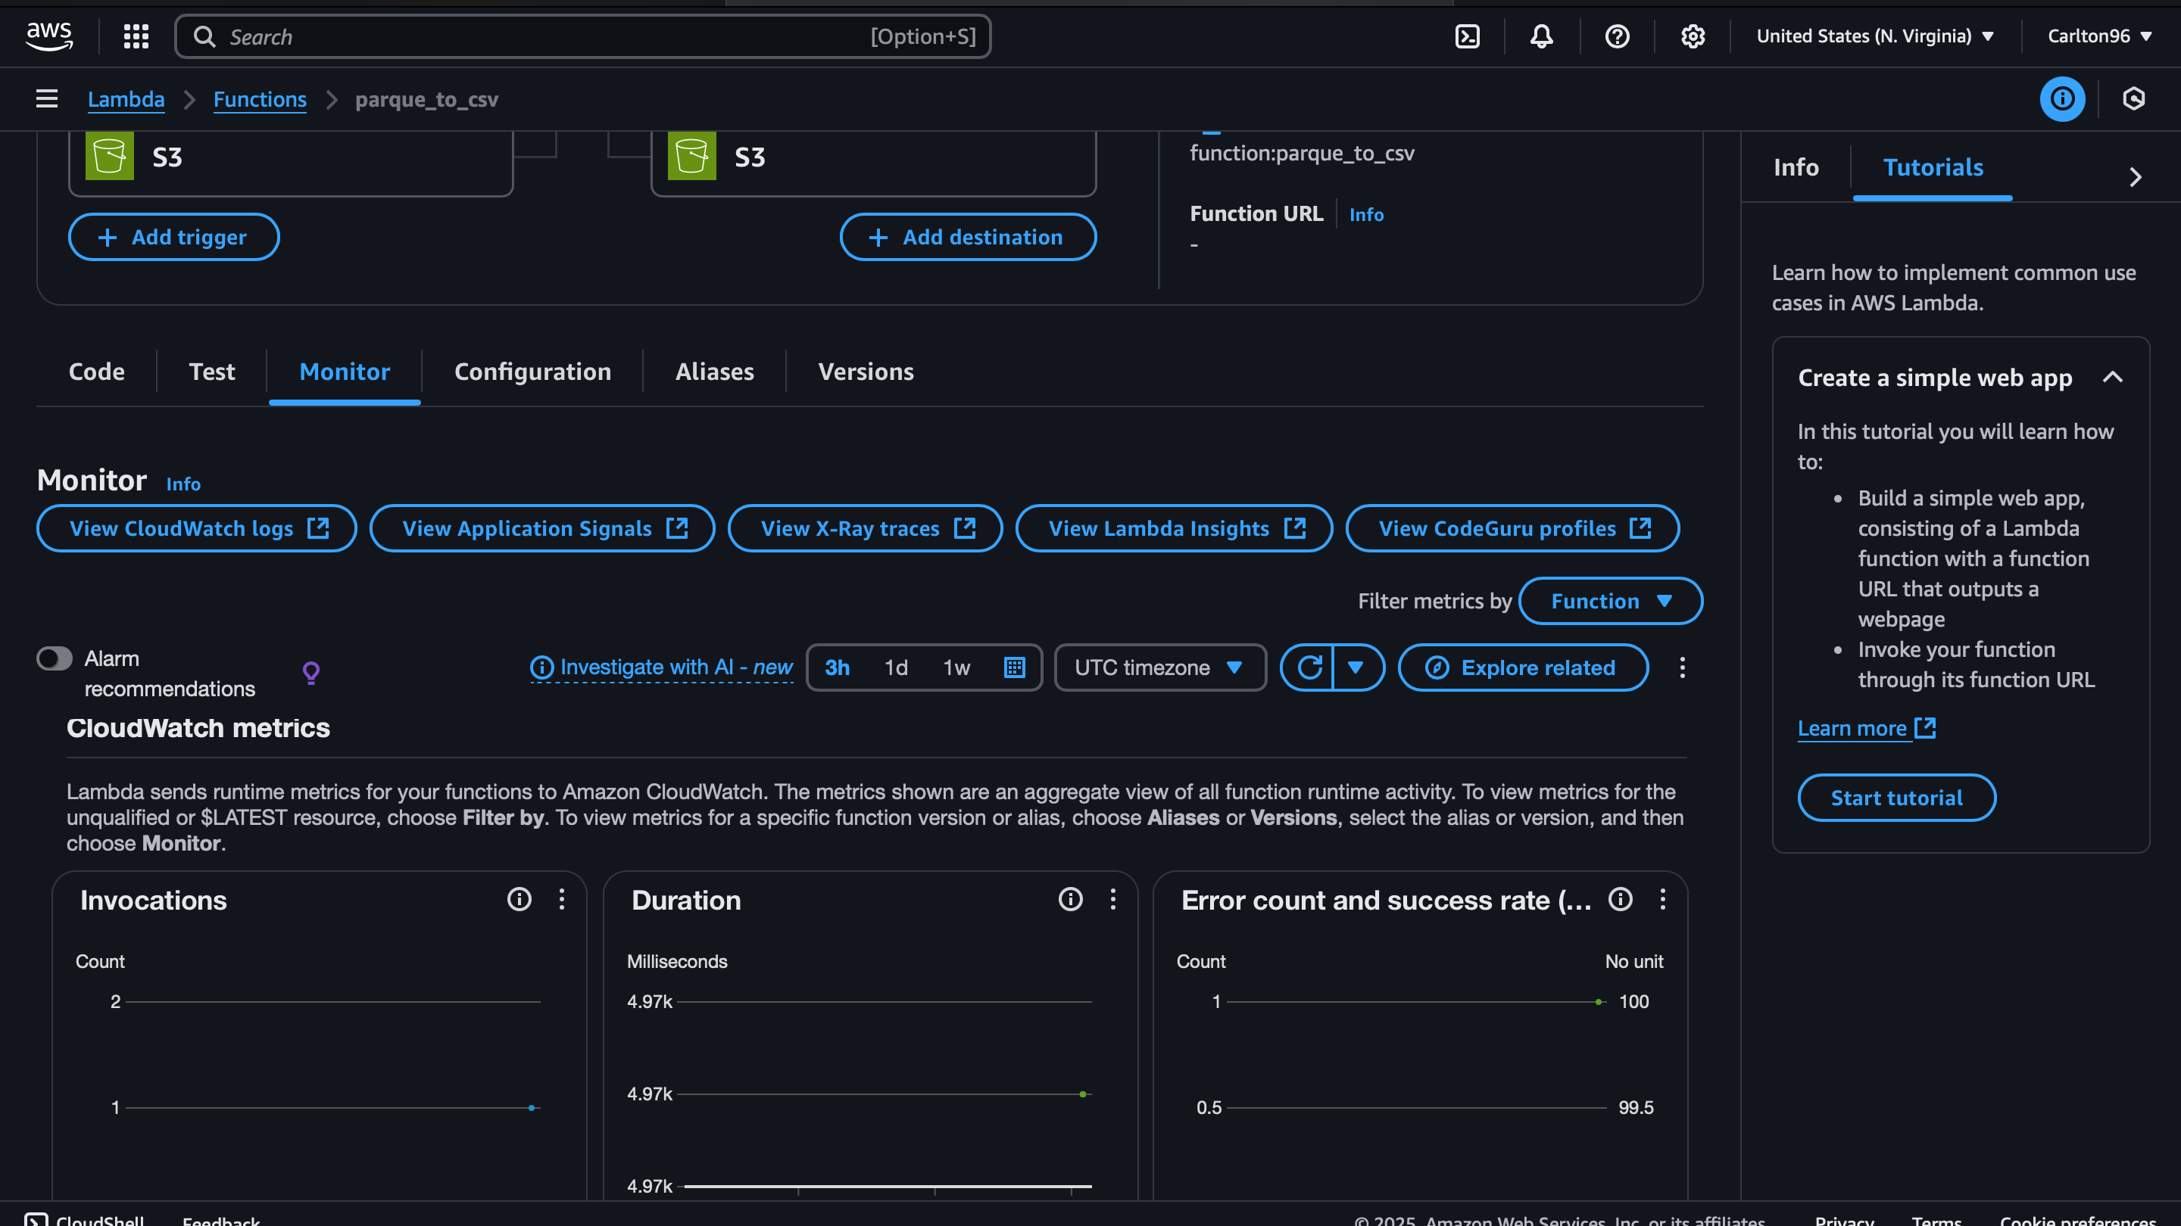
Notes:
Monitoring logs with CloudWatch metrics by checking Invocation,….etc

Slide 11
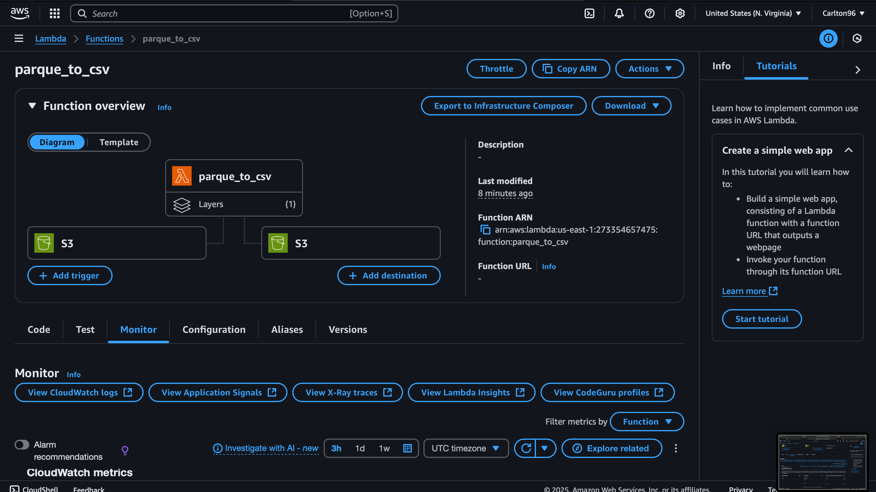
Notes:
Lambda function Overview showing the Function, Trigger and the Destination

Slide 12
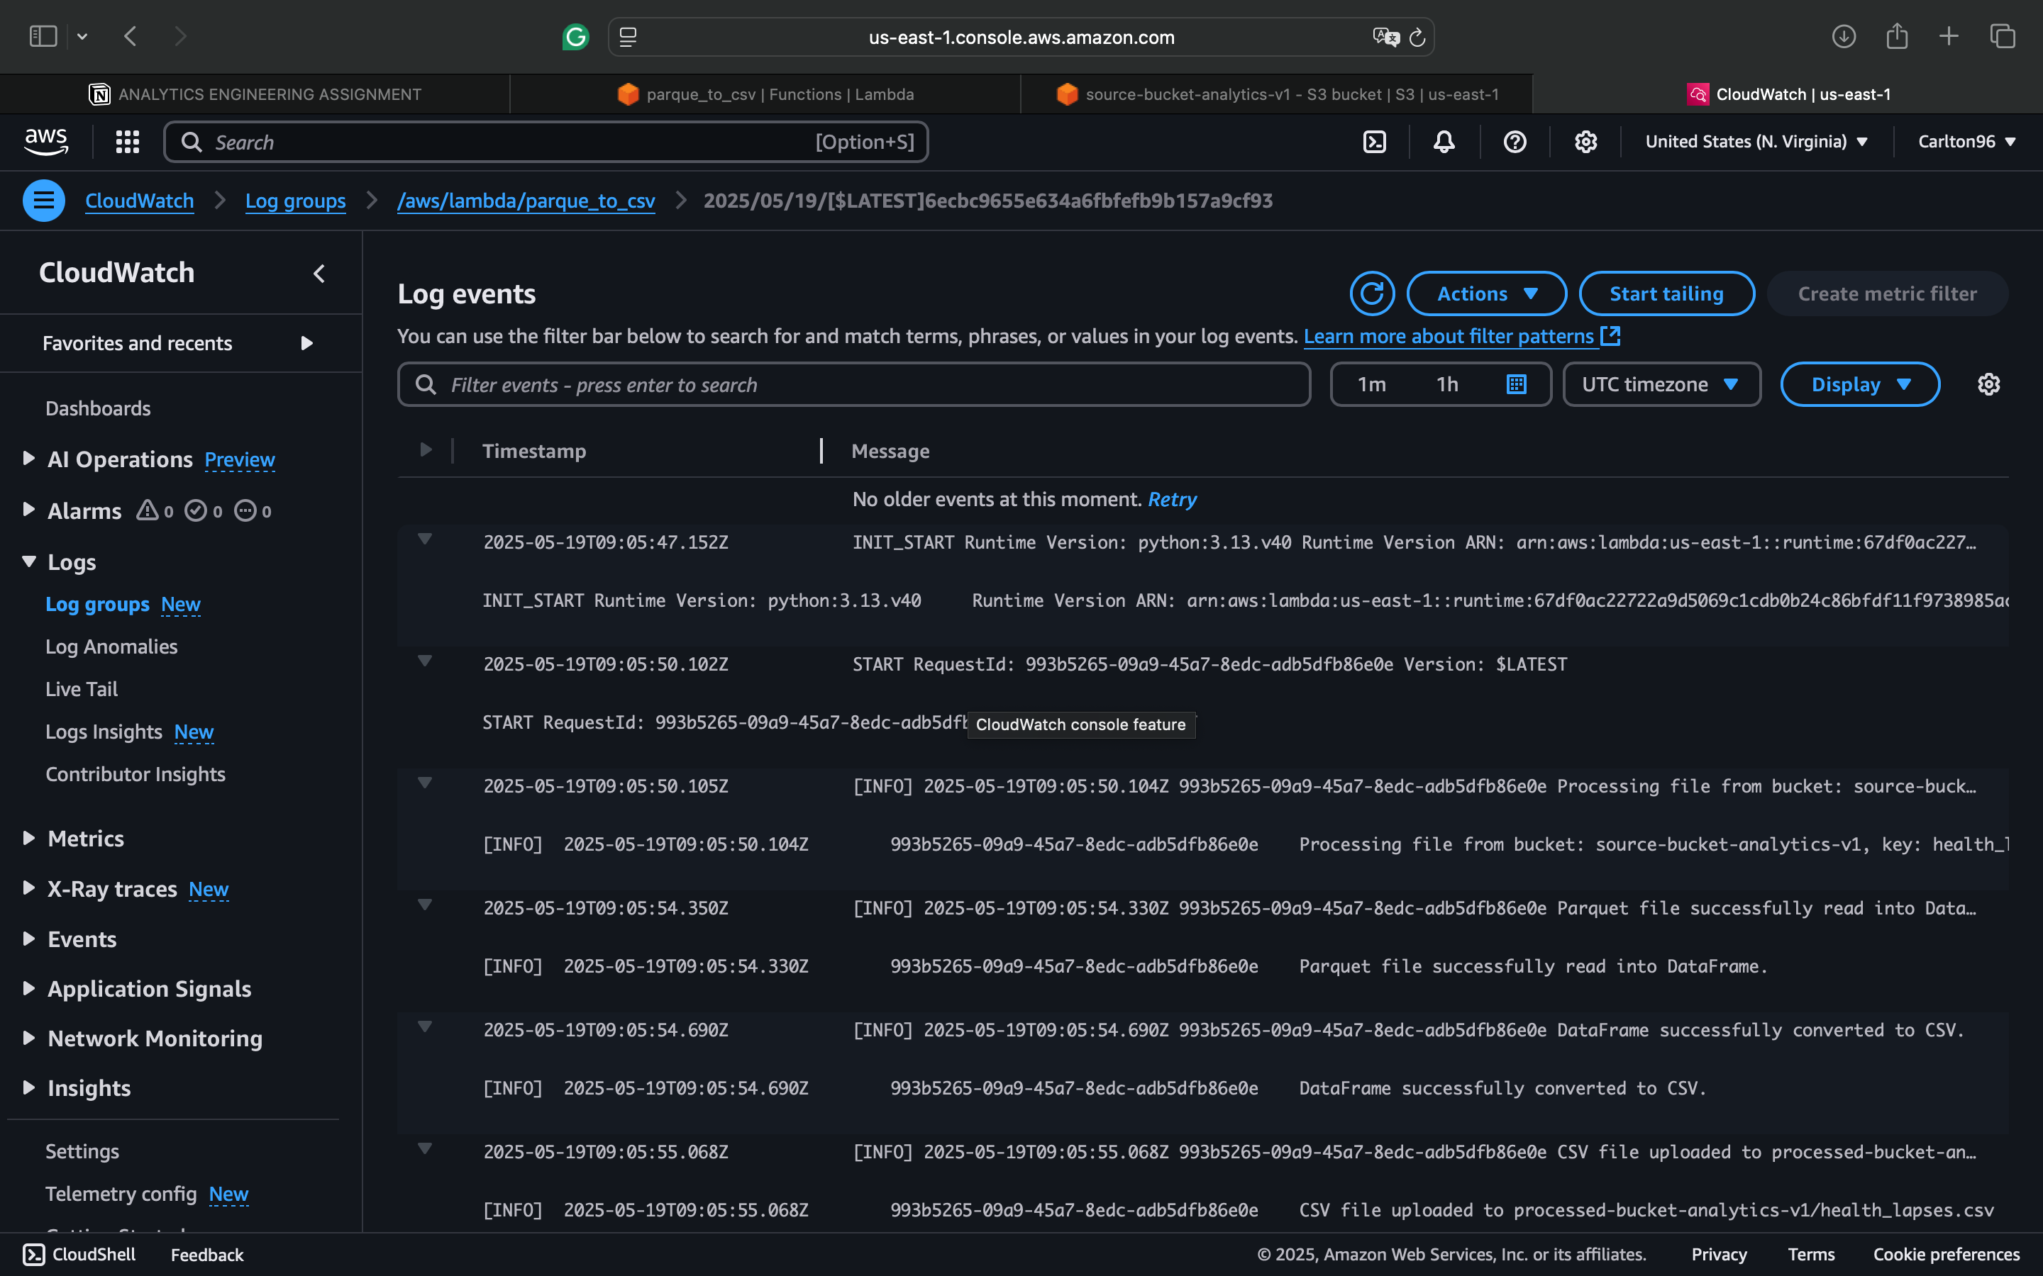
Notes:
Checking Cloud watch log events for Error management if there is any or if it’s Successful

Slide 13
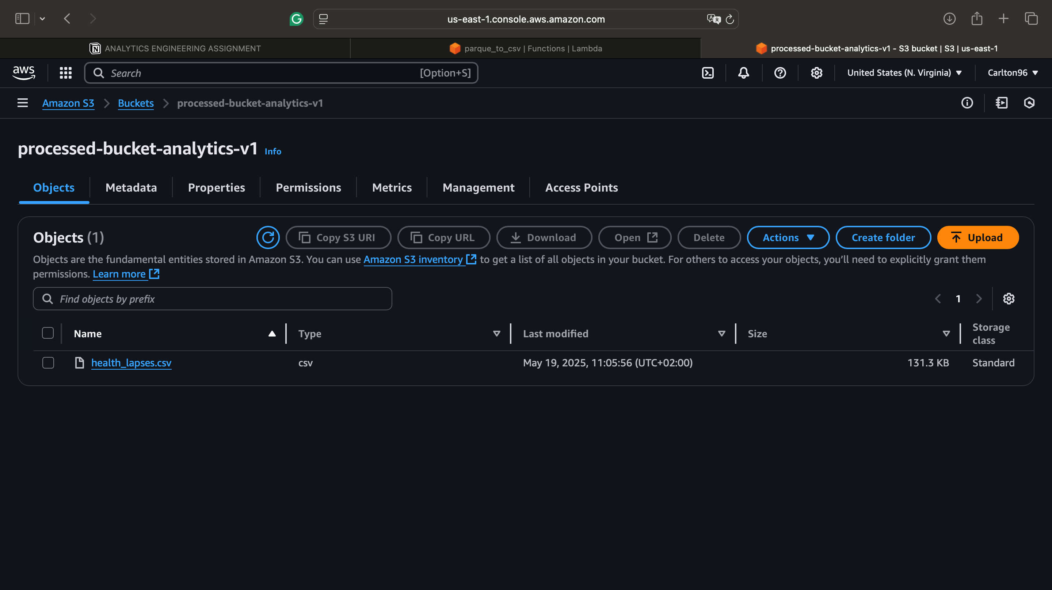
Notes:
File successfully uploaded in the processed bucket

Slide 14
Task 2
Objectives
Convert a .txt file into a CSV file using Python and an IDE of your choice - provide steps
and relevant code for this transformation

Slide 15
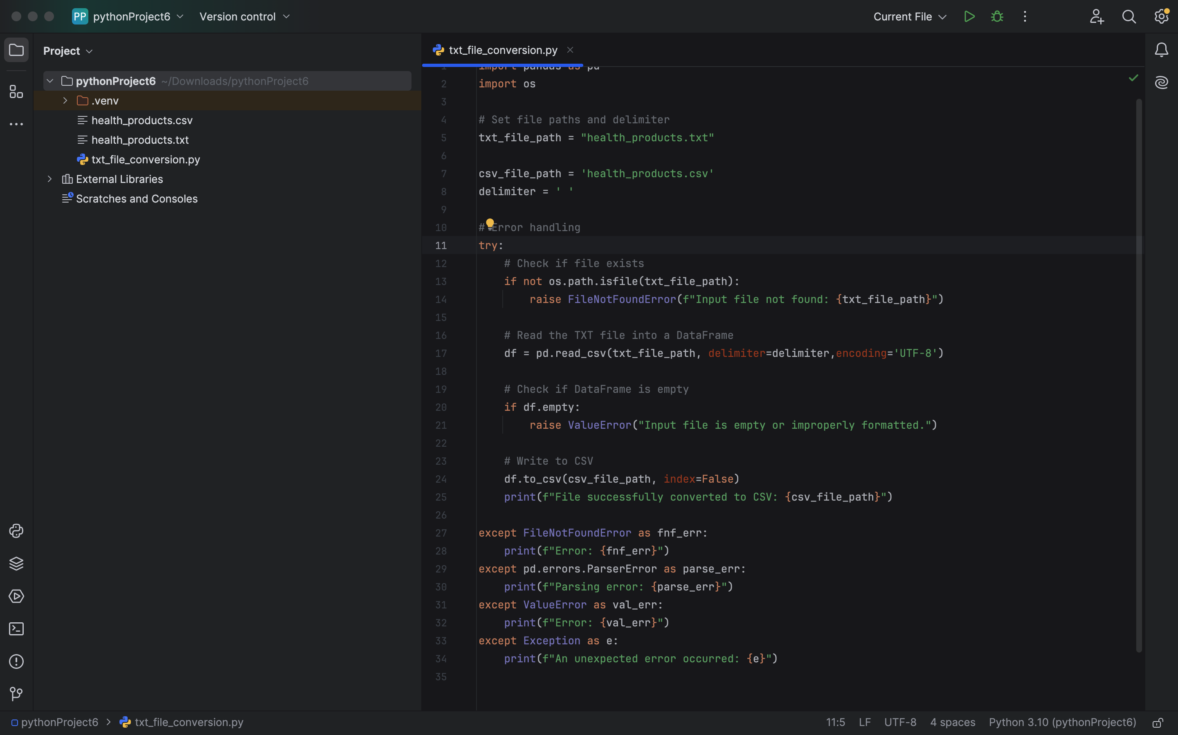
Notes:
Python code for conversion of .txt file to .csv

Slide 16
Task3
Objectives
Create a schema and three different tables in DBeaver by using the CSV output files from

Slide 17
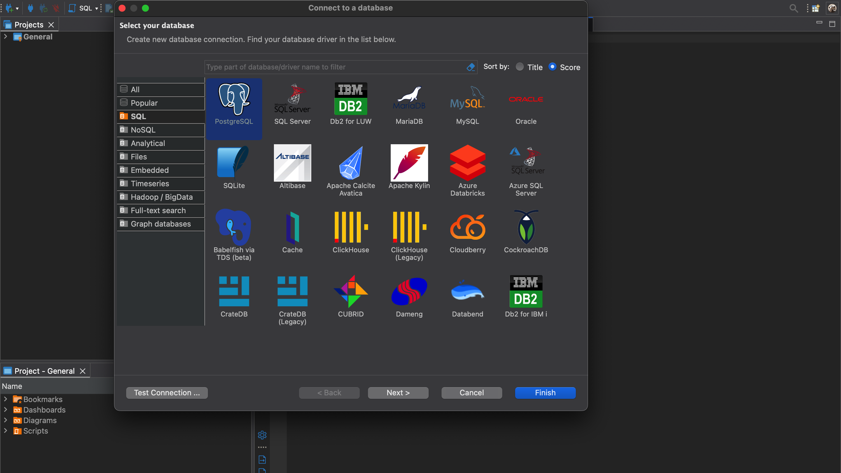
Notes:
Downloading and setting Up Dbeaver and PostgresSQL

Slide 18
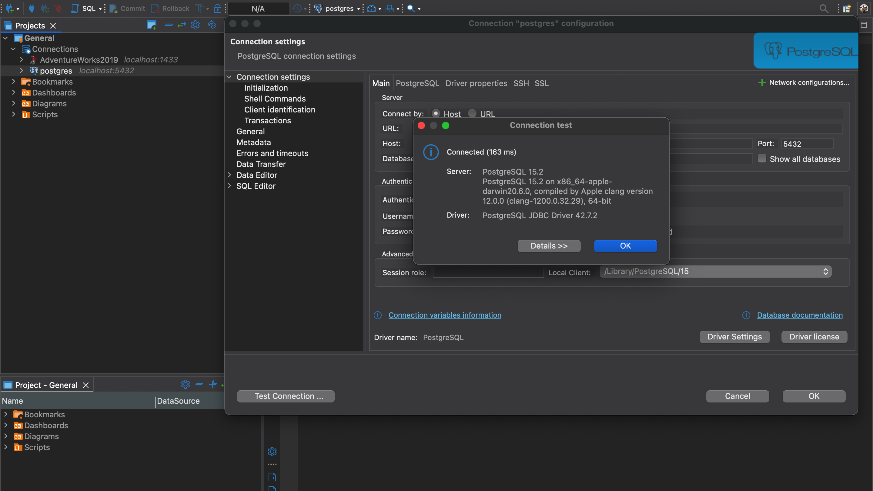
Notes:
Connecting Postgres And Dbeaver

Slide 19
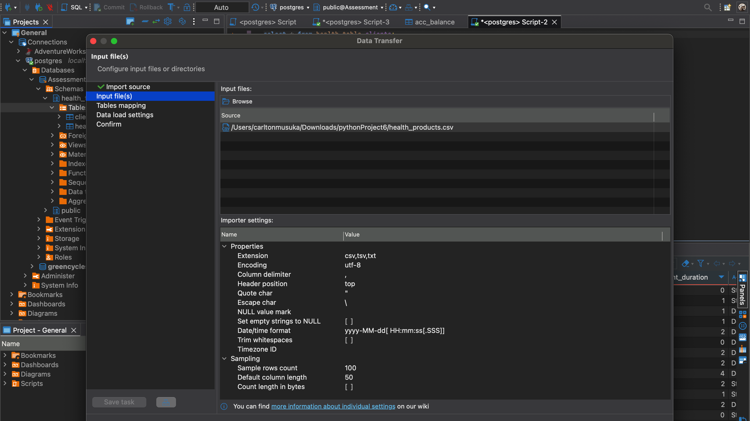
Notes:
Ingestion of the .csv Files

Slide 20
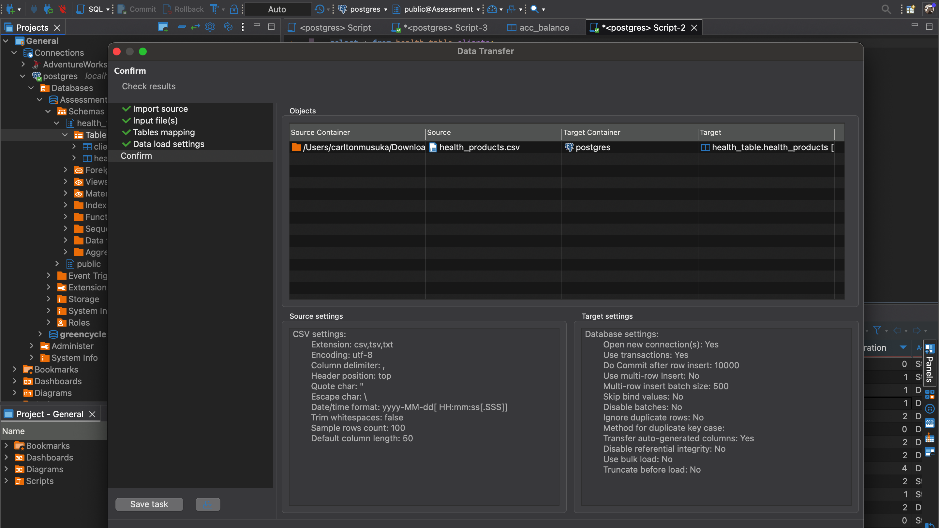
Notes:
Ingestion of the .csv Files

Slide 21
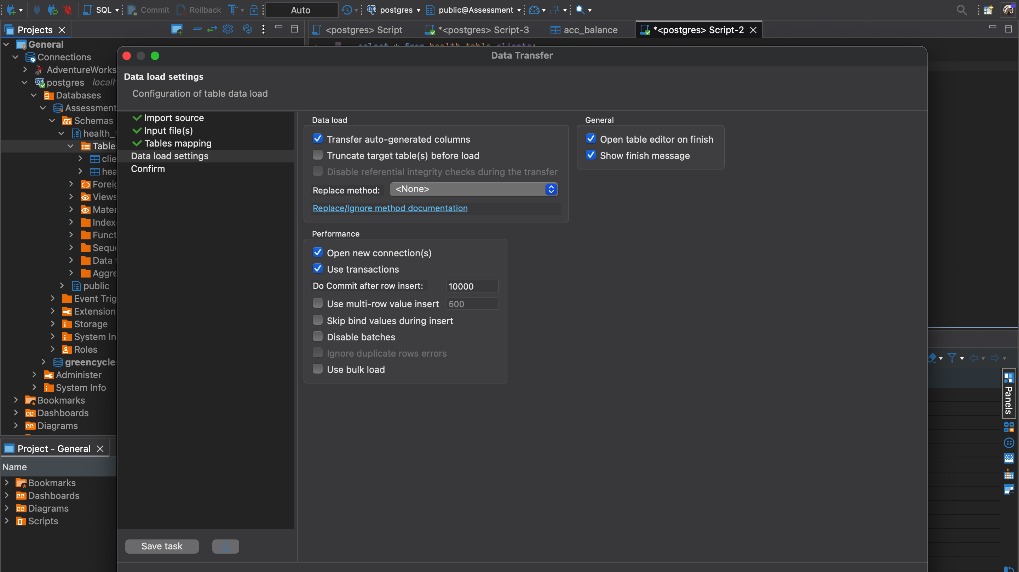
Notes:
Ingestion of the .csv Files

Slide 22

Task 4
Objectives
Clean the data so that it’s ready for analysis
Joins the three tables into a unified dataset (structure based on common keys/columns)
Are there any duplicate rows based on the id column, and if so, how many?
What is the mean income per province and gender? If the income value is NULL,
impute the NULL values. Provide motivation for your method of imputation.
Which payment method is used by most customers per bank?

Slide 23
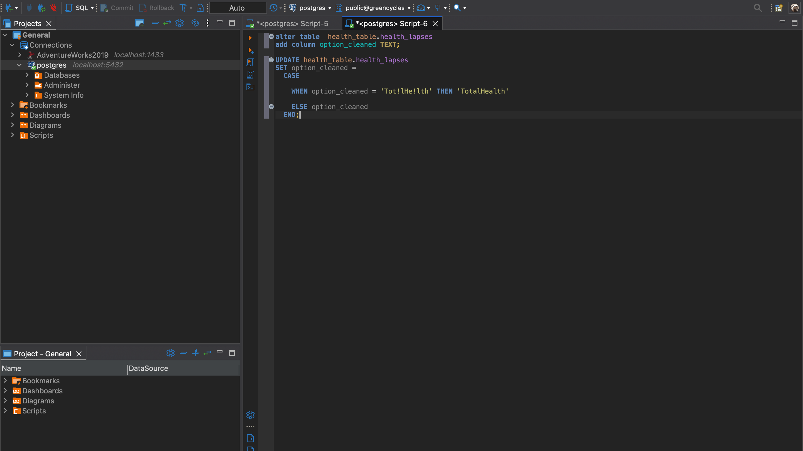
Notes:
Example of how I cleaned the data using SQL

Slide 24
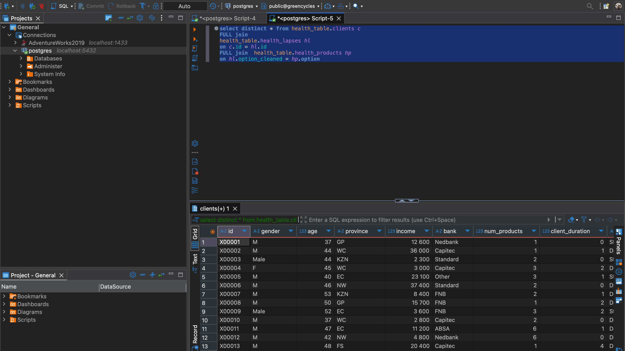
Notes:
Joining Tables based on similar columns

Slide 25
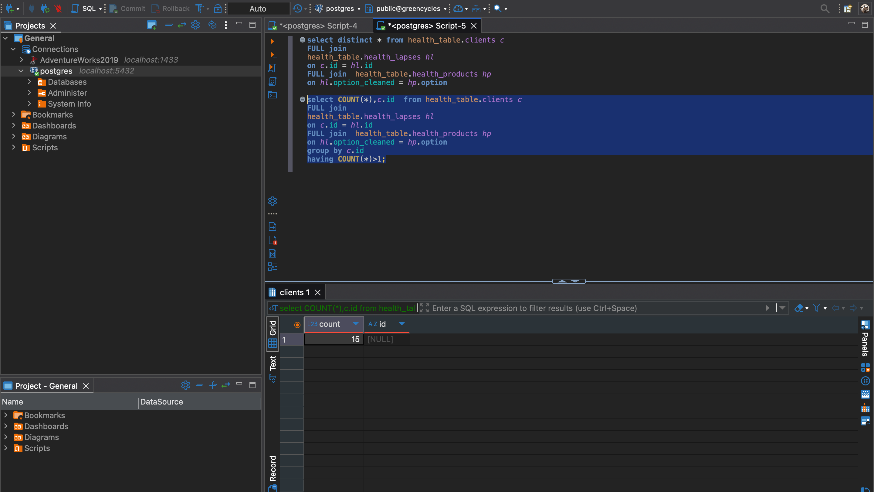
Notes:
Found 15 Duplicate rows

Slide 26
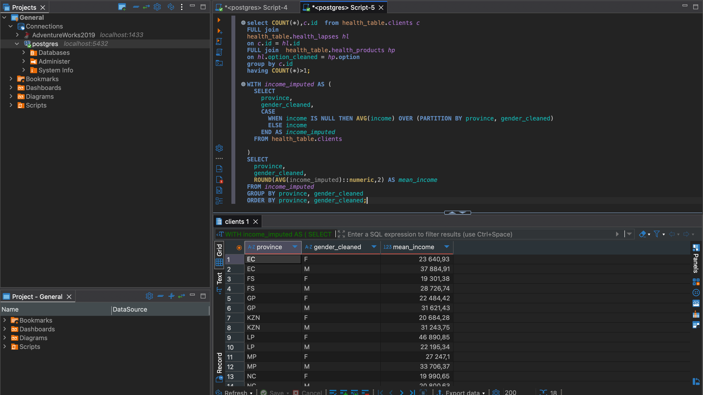
Notes:
Mean Income Per Province and Gender

Slide 27
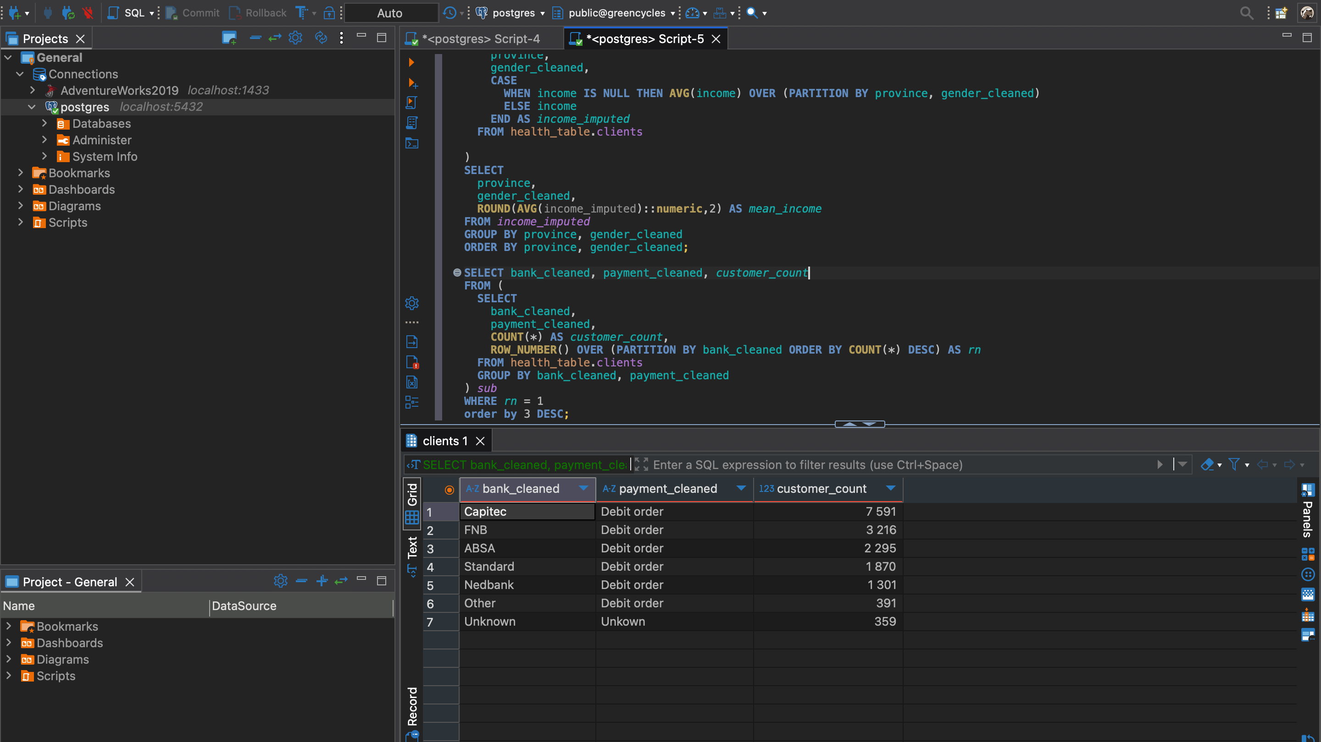
Notes:
Payment method Being used most by customers per bank

Slide 28
Task 5
Objectives
Build a dashboard to share insights gained from the dataset

Slide 29

Dashboard Insights

Slide 30
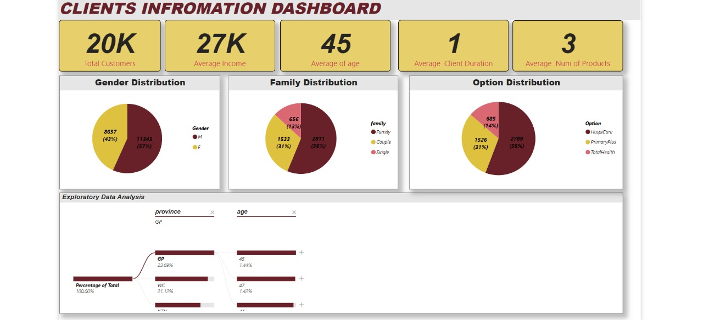
Notes:
Payment method Being used most by customers per bank

Slide 31
Findings
We have about 20K customers
The average Income is roughly R27K
The average age is 45
The average client duration is 1 year
The average number of products is 3
We have more Male patients than female
Under family distribution we have more family then couples then lastly singles
The most common option is Hospicare followed by Primaryplus then Total Health

Slide 32
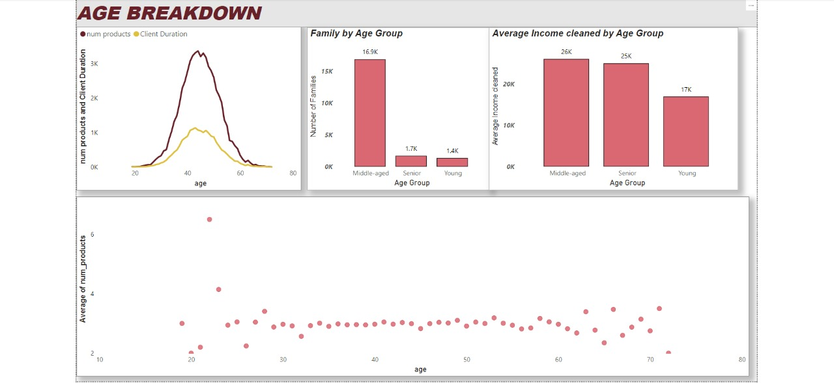
Notes:
Payment method Being used most by customers per bank

Slide 33
Findings
The normal distribution indicates that middle-aged customers tend to hold the most products and have longer client durations
Recommendation-hence we can target middle aged customers with campaigns

Slide 34
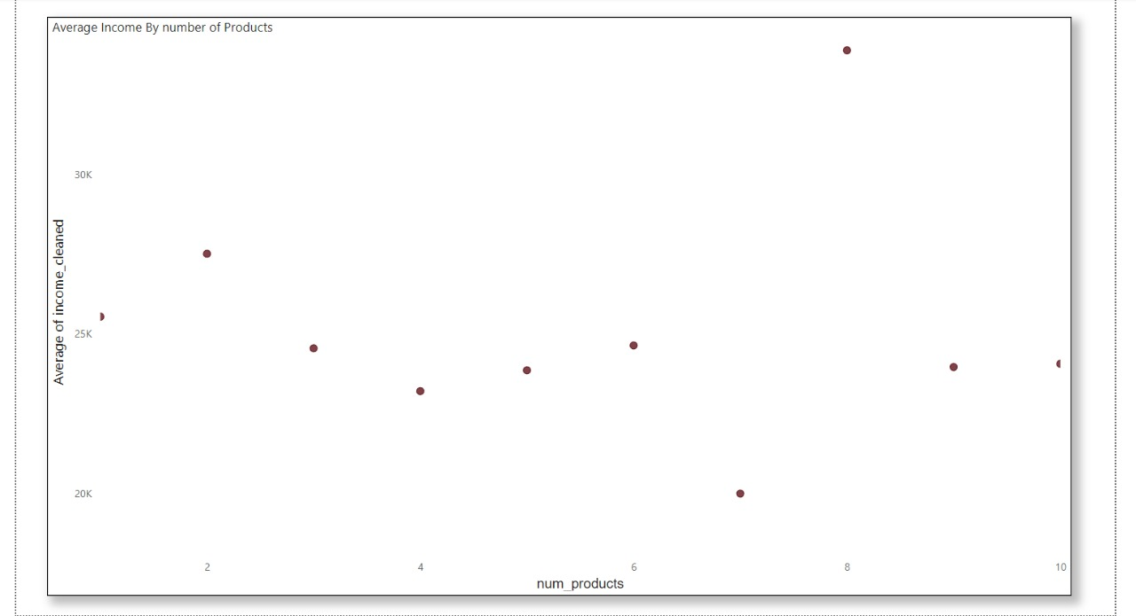
Notes:
Payment method Being used most by customers per bank

Slide 35

Findings
There is no real direct relationship between income and and number of products as shown by the above graph

Slide 36
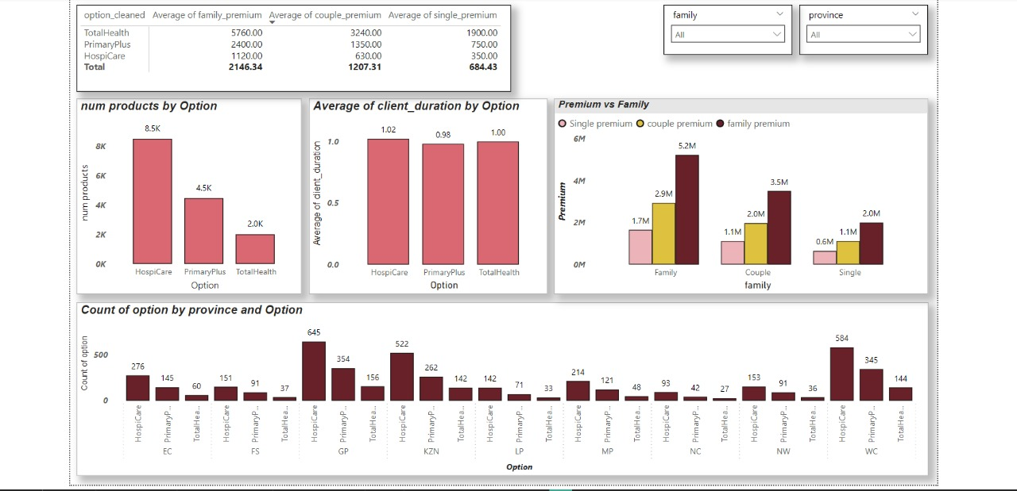
Notes:
Payment method Being used most by customers per bank

Slide 37
Findings
The most number of products are under Hospicare as it is on average the cheaper option as compared to the other two
Even though TotalHealth is slightly more expensive than Primaryplus ,it has higher client duration on average

Slide 38
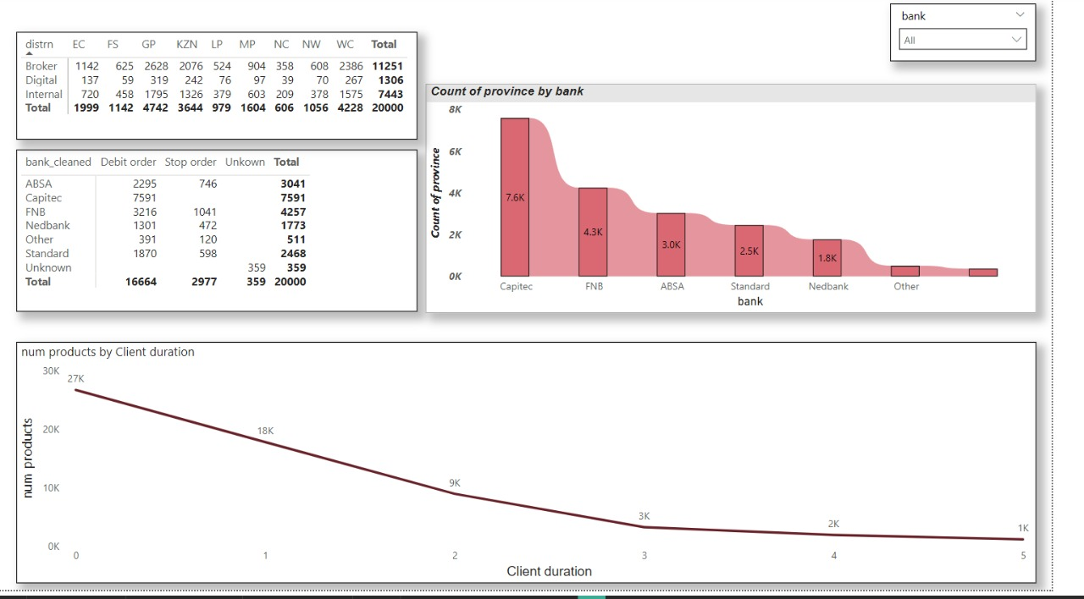
Notes:
Payment method Being used most by customers per bank

Slide 39
Findings
There is a positive relationship between client duration and number of products, suggesting that clients tend to acquire more products over time
The most used bank by clients is Capitec which can be useful in creating or establishing a partnership
The majority of customers were referred by brokers, highlighting an opportunity to strengthen and leverage broker partnerships

Slide 40
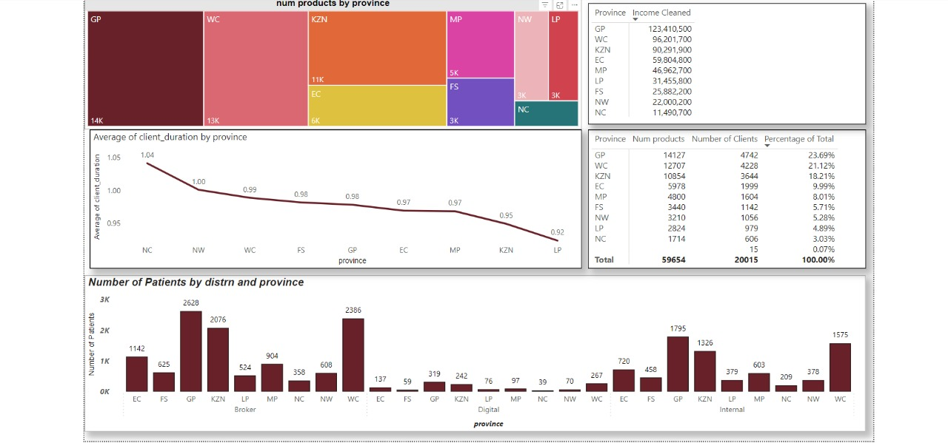
Notes:
Payment method Being used most by customers per bank

Slide 41
Findings
The majority of our customers are from Gauteng province, accounting for approximately 24% of the total, while the Northern Cape has the lowest representation at around 3%
Launch loyalty programs in Gauteng to retain and further engage our largest customer base.
Initiate targeted marketing campaigns in the Northern Cape to boost awareness and increase customer acquisition in this underrepresented region.
However even though we have 3% in NC we have the highest average client duration of about 1.04 and LP has the lowest average client duration of about 0.92

Slide 42
DBT

Slide 43
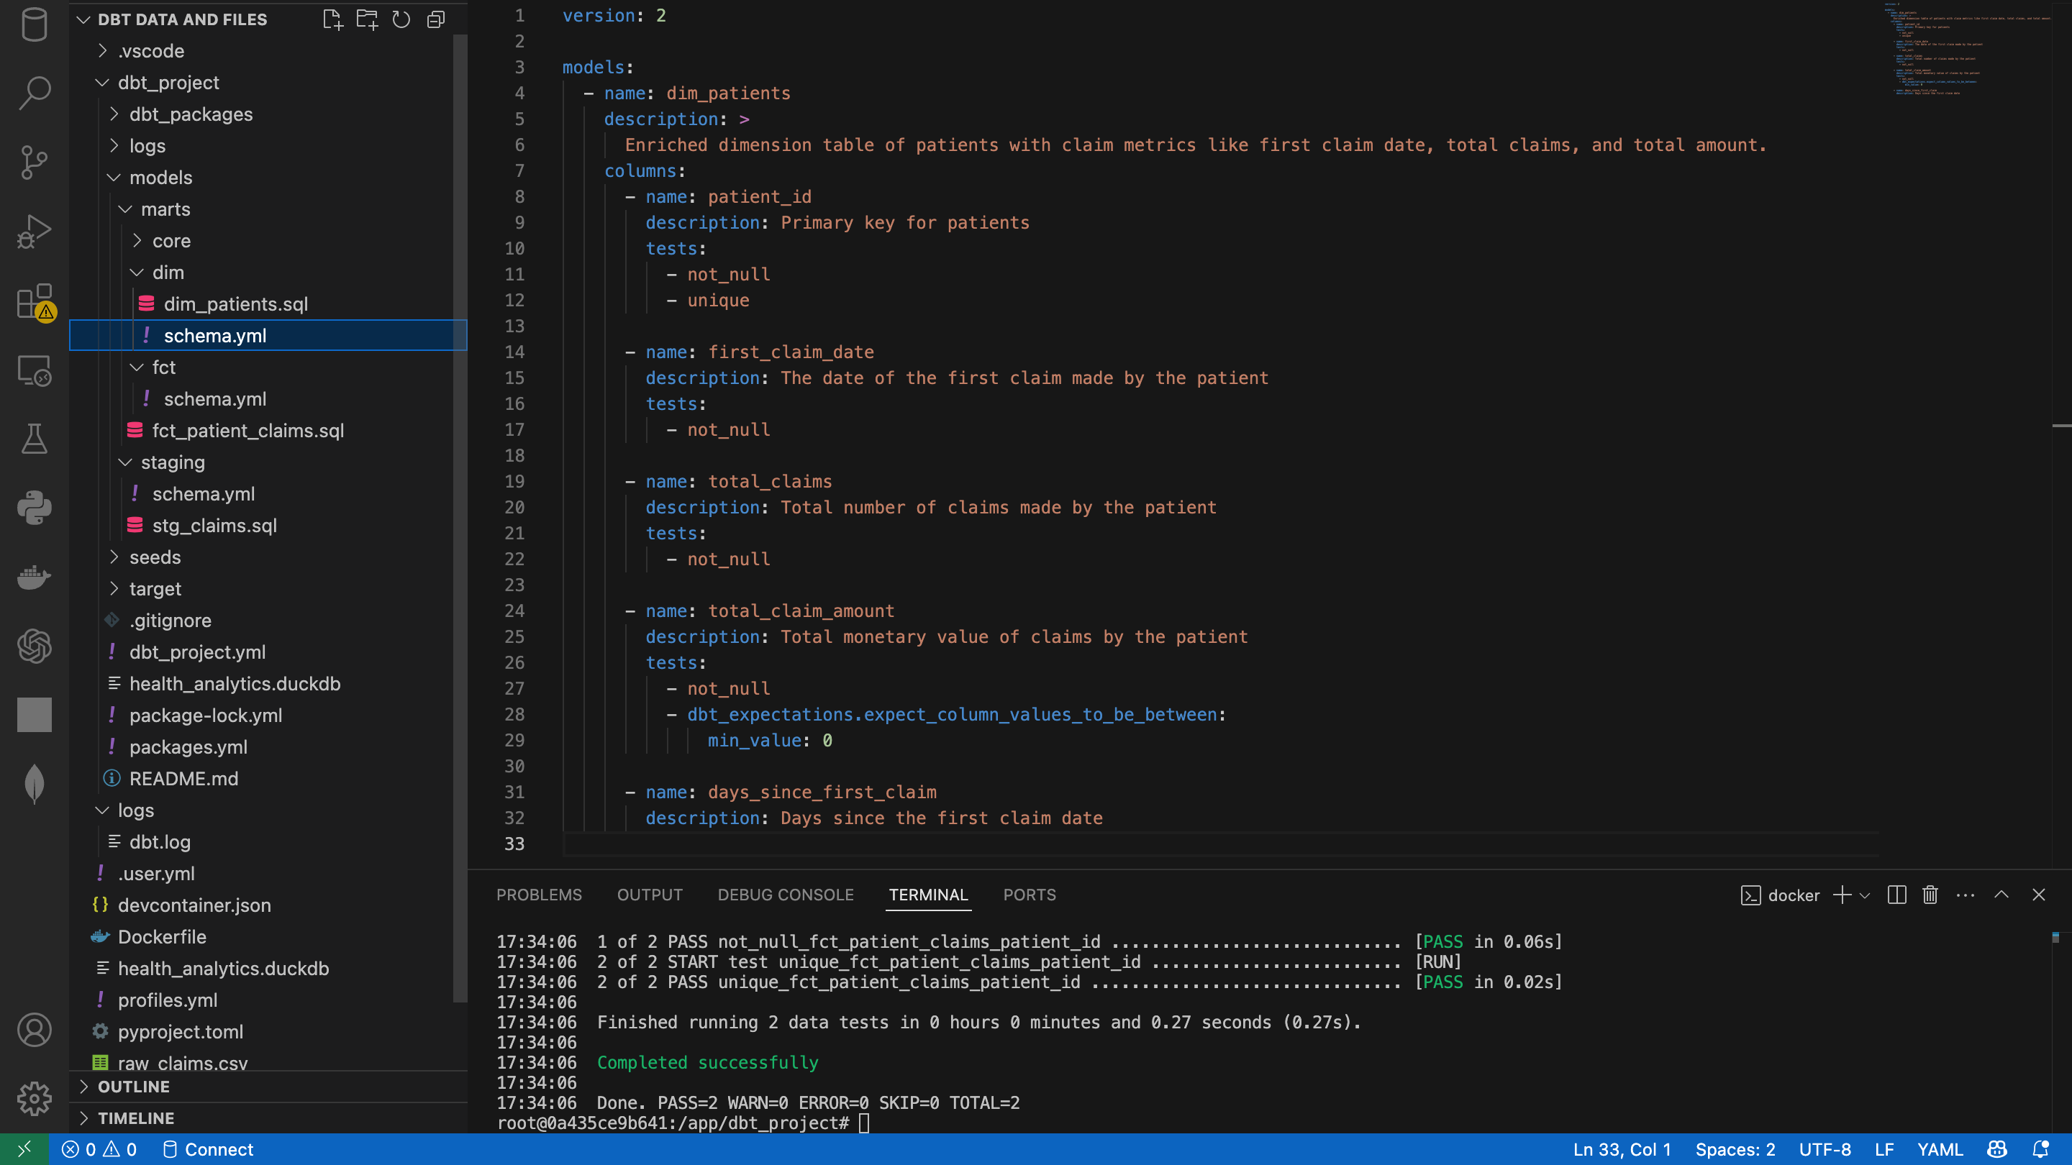
Notes:
Payment method Being used most by customers per bank

Slide 44
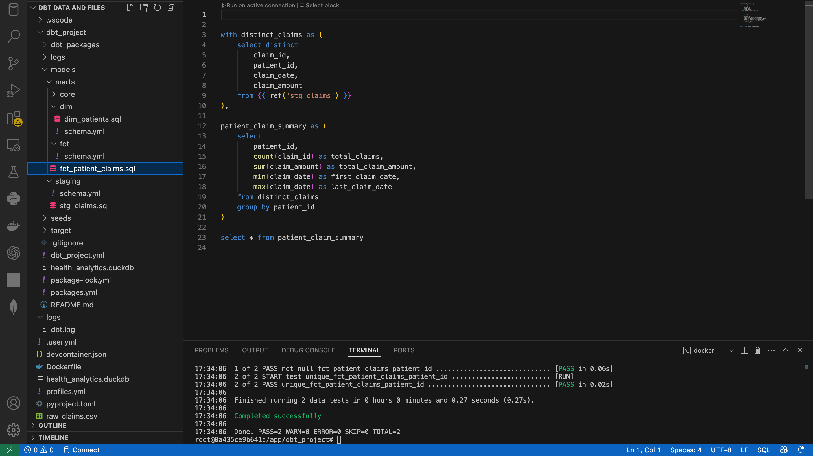
Notes:
Payment method Being used most by customers per bank

Slide 45
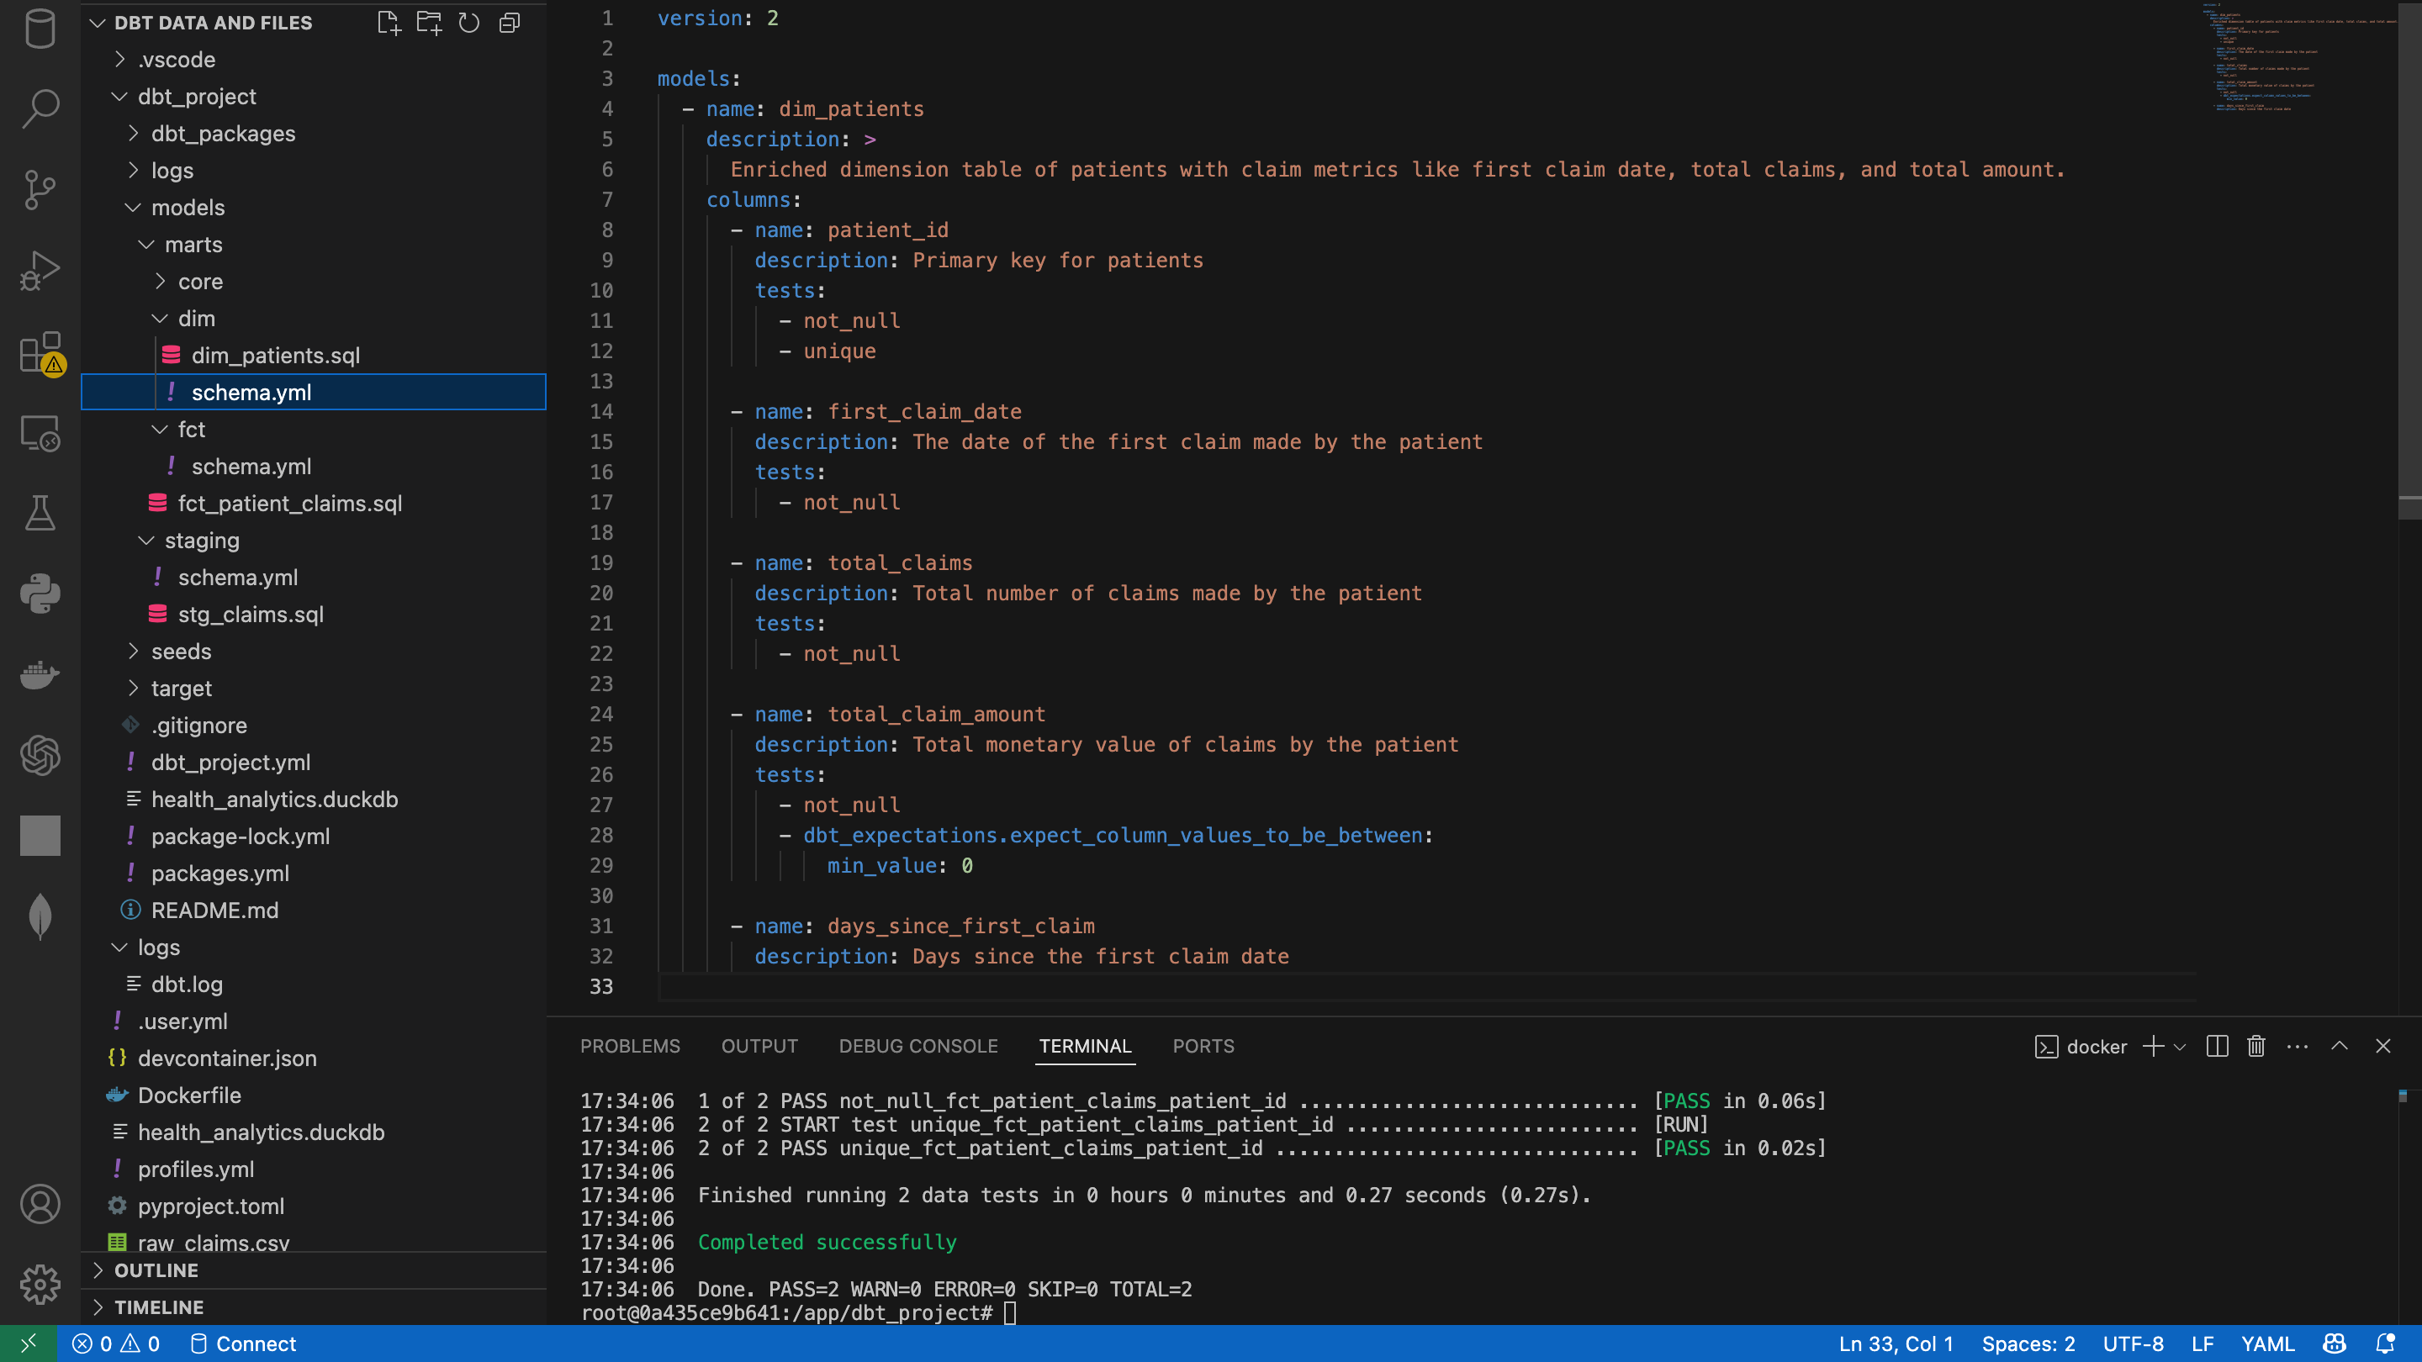
Notes:
Payment method Being used most by customers per bank

Slide 46
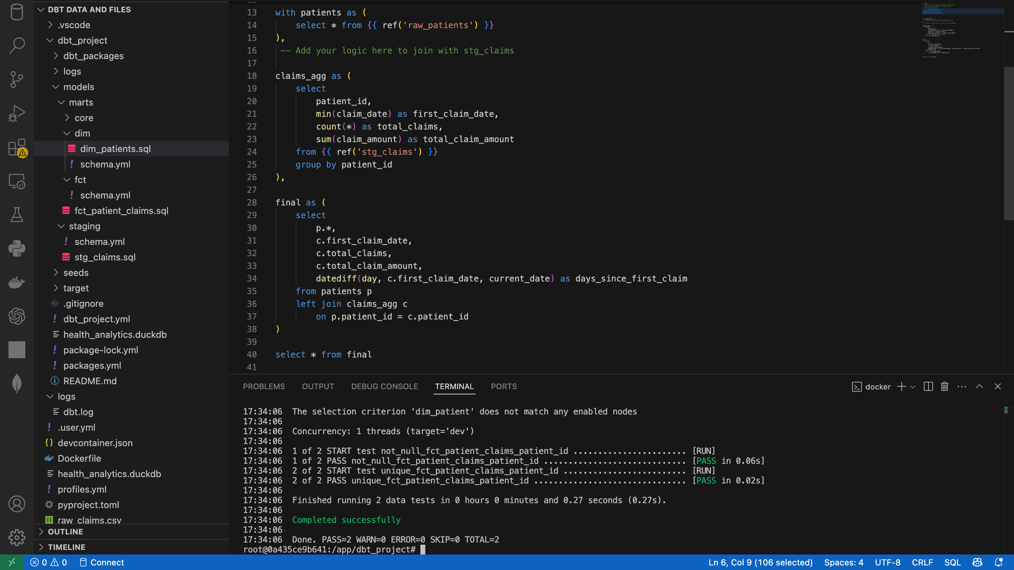
Notes:
Payment method Being used most by customers per bank

Slide 47

Thank You

